Slide 1
Kansas County Highway Association Annual Meeting KDOT UPDATE
Tod Salfrank, Bureau Chief – Local Projects
Kansas Department of Transportation

Slide 2
Personnel Changes
Kassiah Martin, Senior Admin Assistant
replacing Kathryn Waters
Kassiah.D.Martin@ks.gov
(785) 296-3861

Slide 3
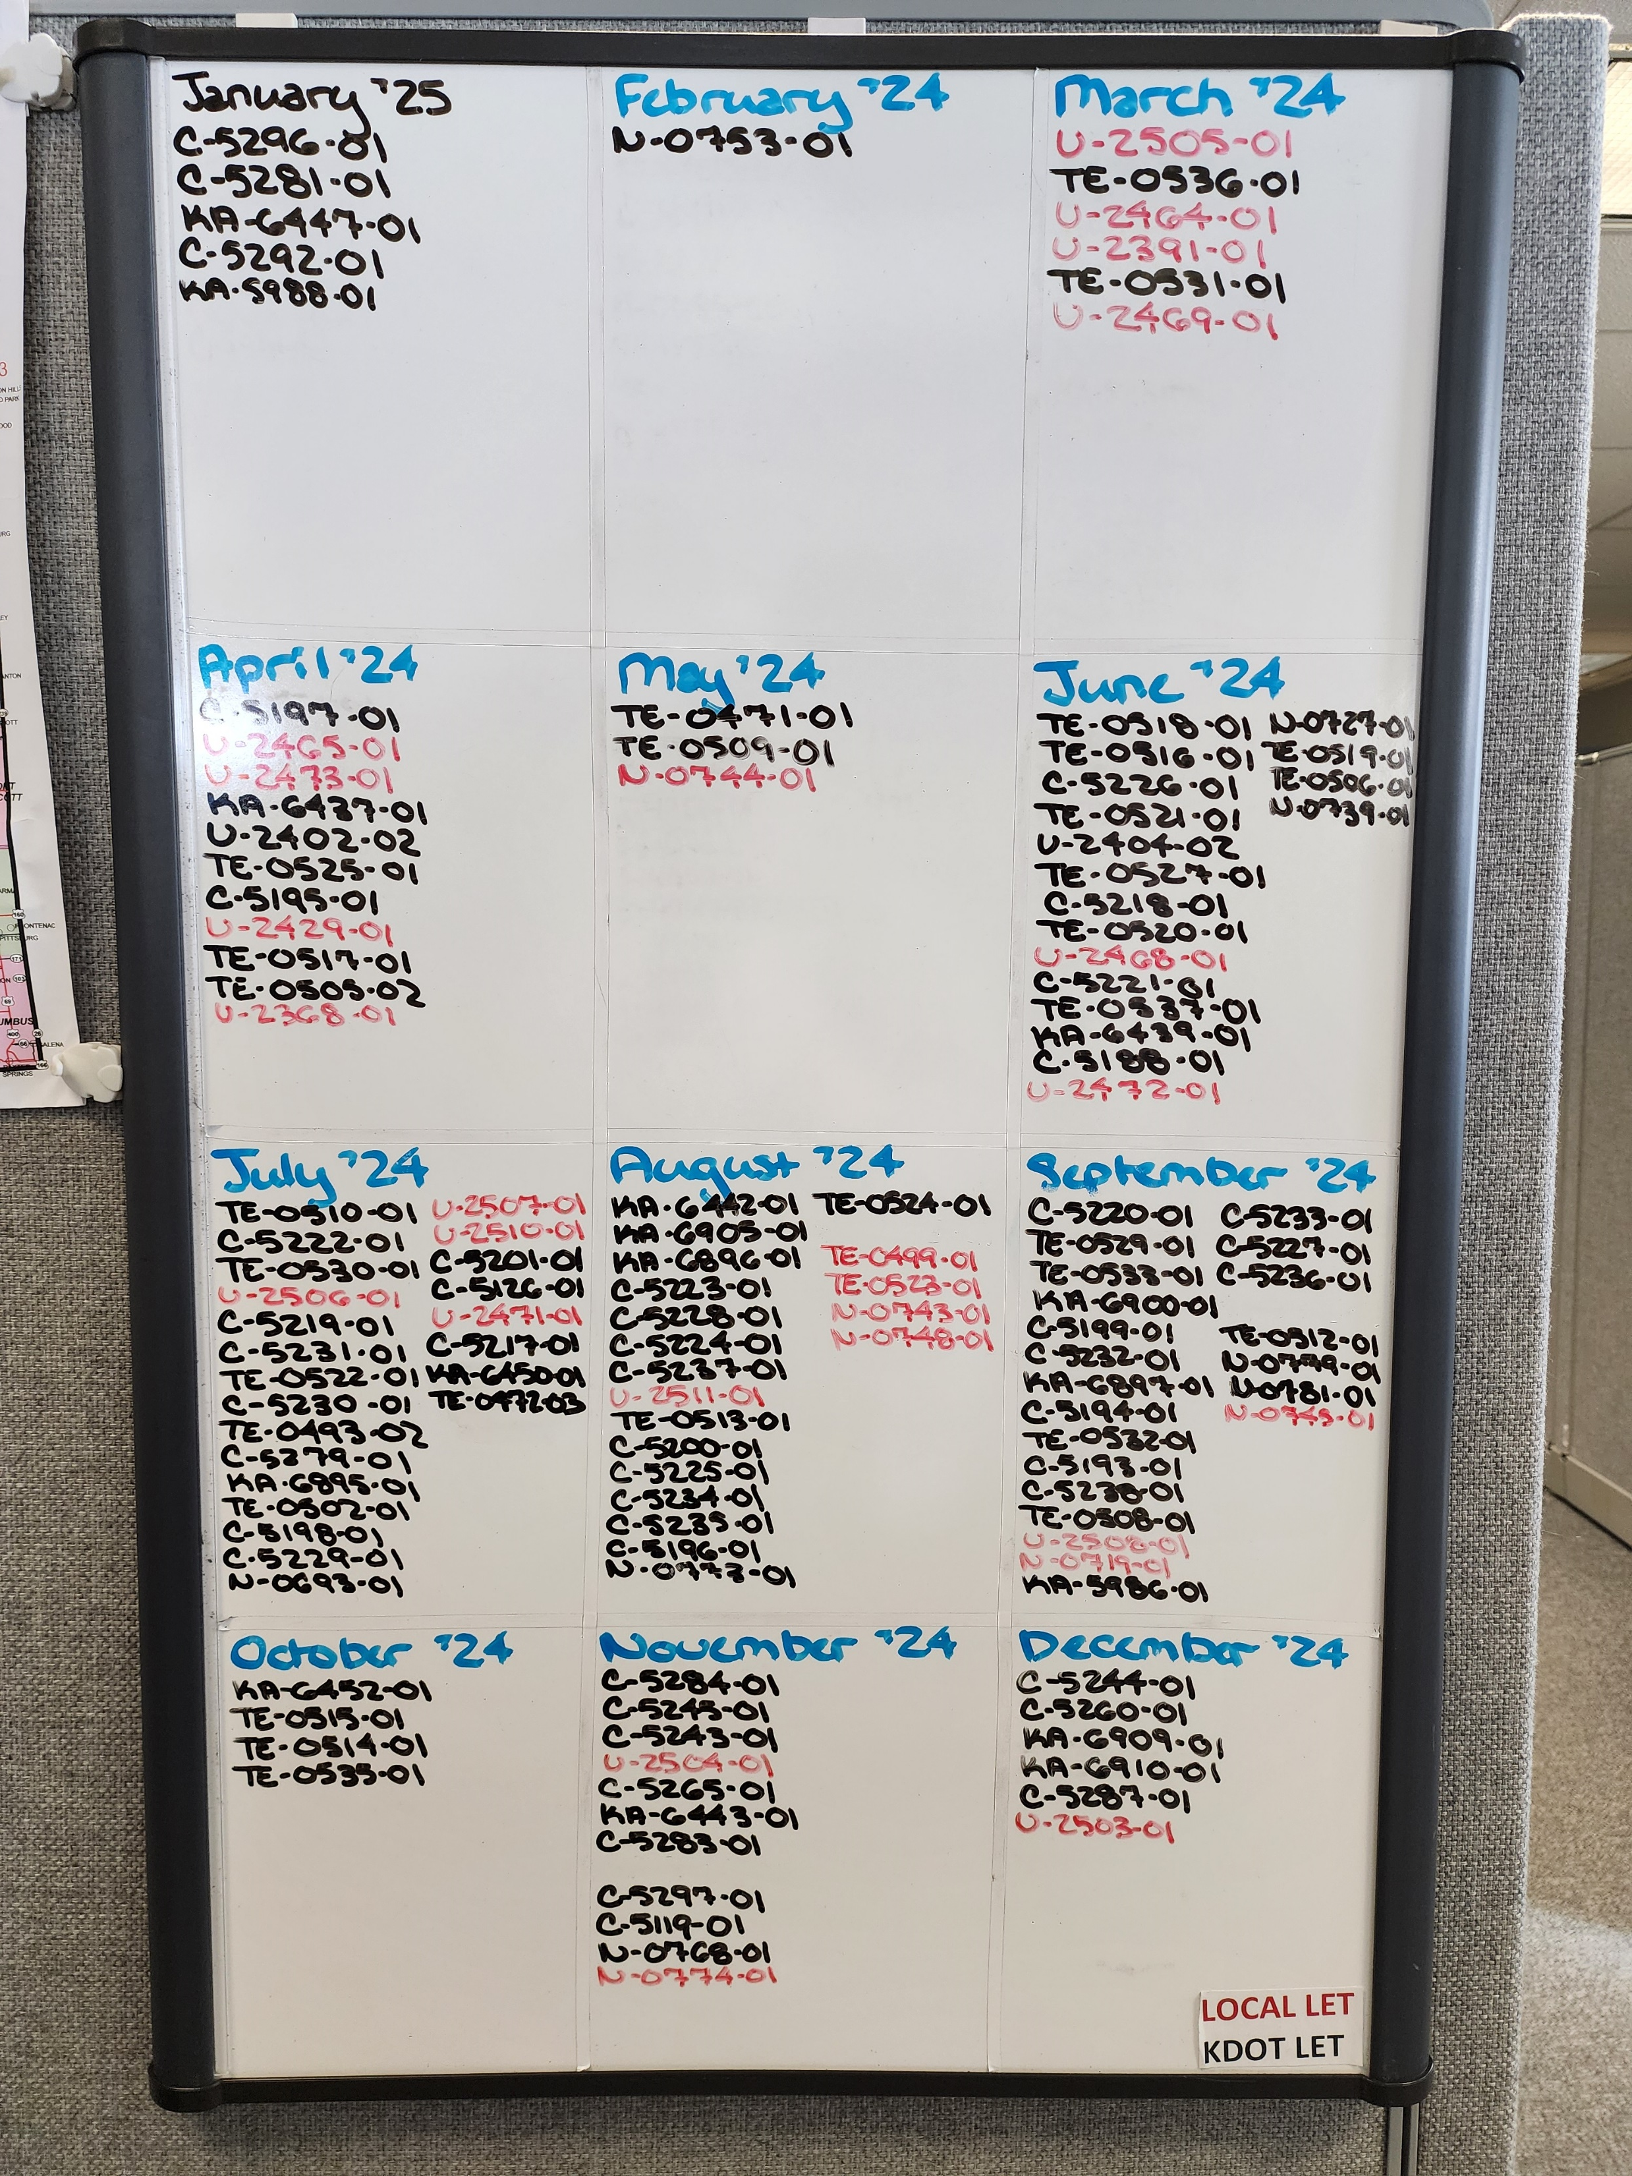
Project Schedules

Slide 4
Project Schedules (Con’t)
Projects are Locally owned – These are YOUR projects, not KDOT’s. Keeping on track is your responsibility.
Months with a lot of projects in the letting tend to get higher bids.
Kansas receives a finite amount of Federal $ available to spend each year, and they expire on Sept. 30 of that year.
If your project does not get let in the year it was programmed for:
KDOT has to find a place to spend the Federal $.
KDOT has to find Fed $ from the next year in order to allow you to do your project.

Slide 5
KLIP Tool Update
Moving to KDOT server
Update of 2021 and 2022 County Engineer Report Data
Update Bridge Data to 2022 FHWA submittal
Improved functionality on both Historic Data Viewing and Scenario Planner
Should be in place later this summer

Slide 6
Bridge Inspection Updates
Electronic Bridge Inspection (EBI) Active June 3, 2024
Meet future requirements for BRM 7.0 and SNBI
Field Testing
Training for inspectors
Bridge Inspection portal will be “READ ONLY”
Can be used to get past inspection documents such as pictures, Load Rating Summary sheets, Scour Critical information, etc. prior to going to field.

Slide 7
FFE Updates
2024 FFE documents have been sent!!!
Remember: Due to increased Off-System Bridge Program (per federal requirements) FFE amounts Are lower beginning this year!
Kimberly Marotta is still the FFE Program Manager

Slide 8
Bridge Program Updates
2026 Off-System Bridge and 2025 KLBIP will be funded at about the same levels as previous year. Call for applications are out!
Guidelines did not change!
Get you applications turned in now!!!

Slide 9
HRRR Updates
FFY 2025 selection process complete
Announcement coming soon!

Slide 10
Pre-project Certification Program
Must be completed by current staff member in position of “responsible charge”
Must be renewed every three years
Projects will not be programmed until completed

Slide 11
NEPA Bat Update
No clear direction from USFW on requirements
Upcoming Projects – to expedite NEPA clearance, you may be asked to remove or trim trees in project area to 3 feet prior to April 1 each year. Otherwise, contractor will not be able to remove until November.
Sites will be reviewed at Field Check for bat habitat or presence. This is affecting timelines for NEPA Clearance as well.

Slide 12
Planning Request for Information
Planning has sent out (is sending) requests for counties to provide pavement types for all roads
Review Functional Class for accuracy at same time
This is required for Kansas to stay in compliance for federal aid.

Slide 13
Questions?
Tod Salfrank, Chief
KDOT-Bureau of Local Projects
Tod.Salfrank@ks.gov

Slide 14
Thank you!!

